Slide 1
Flat Fee Pricing
Module 6 · Video 6
Management 405
Prof. Nico Voigtländer · UCLA Anderson

Slide 2
Module 6 · Video 6 · Agenda
Outline of Module 6
1
Simple vs. Complex Pricing
Video 2
2
Direct Price Discrimination
Videos 3+4
2a
Perfect Price Discrimination (First Degree)
Video 3
2b
Segment Pricing (Third Degree)
Video 4
3
Indirect Price Discrimination (Second Degree)
Video 5
4
Advanced Pricing Strategies
Videos 6–8
4a
Flat Fee Pricing
Unlimited access for one all-or-nothing fee
Video 6
4b
Two-Part Tariff
Video 7
4c
Block Pricing
Video 8
5
Summary of Pricing Strategies
Video 9
Management 405 · Module 6 · Complex Pricing and Advanced Pricing Strategies
2
Notes:
Now we change the question. Instead of many different customers, think about one customer buying many units.

Slide 3
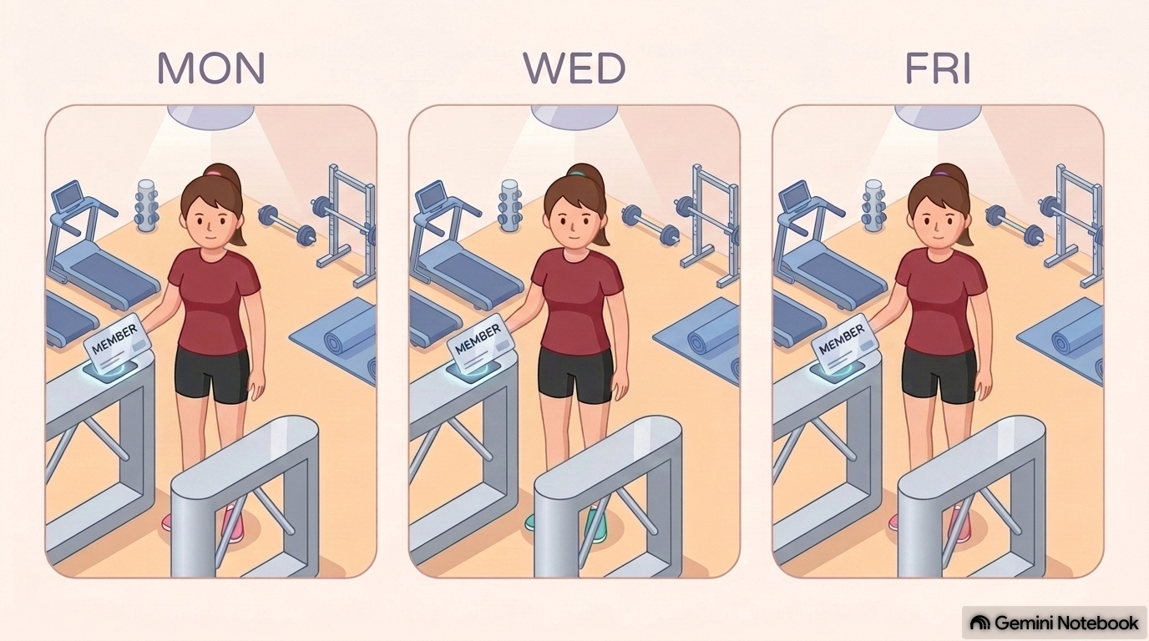
Module 6 · Video 6 · Flat Fee Pricing
Context
So far: we had different consumers with different demand curves (marginal personal value)
  Extract surplus via direct / indirect price discrimination
Now: consumers have identical demand curves, but each of them purchases multiple units of the product
  We will focus on a “representative consumer”
Management 405 · Module 6 · Complex Pricing and Advanced Pricing Strategies
3
Notes:
Everything so far has been about customers who differ from each other. Now hold that aside: imagine every customer has the same demand curve, but each of them buys several units. The surplus is still there to be captured, but the tool is different, because what varies now is the value of the second unit against the first.

Slide 4
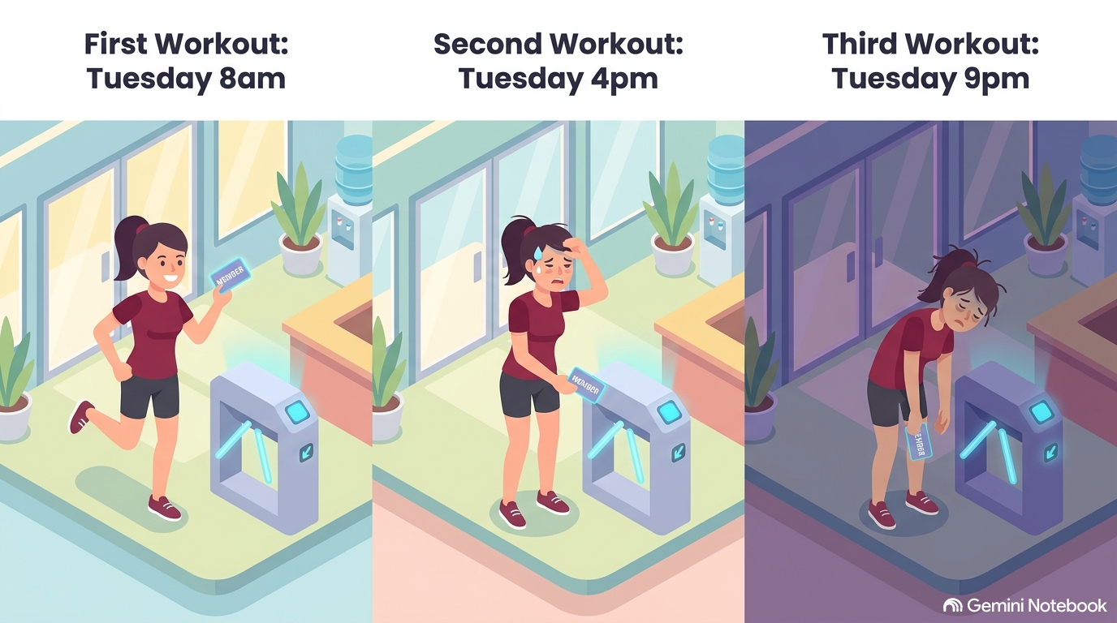
Module 6 · Video 6 · Flat Fee Pricing
Advanced Pricing
How to extract consumer surplus from a given consumer who is prepared to buy multiple units
  Diminishing marginal personal value comes into play
We will study three variants of advanced pricing
  All-or-none offers (flat fee)
  Two-part tariffs (flat fee + usage fee)
  Block pricing
Video 6
Video 7
Video 8
Management 405 · Module 6 · Complex Pricing and Advanced Pricing Strategies
4
Notes:
Three tools, and we take them in order. A flat fee for unlimited access. A two-part tariff, which is a flat fee plus a per-unit charge. And block pricing, where the price falls as the same customer buys more. Which one fits depends almost entirely on whether marginal cost is zero.

Slide 5
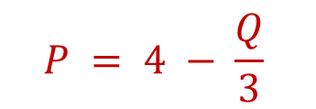
Module 6 · Video 6 · Flat Fee Pricing
Example: Netflix Flat Fee (Assume MC = 0)
P
$$P = 4 − \frac{Q}{3}$$
Triangle = total value of unlimited movies for the consumer = the maximum fee Netflix can charge
Area = (12 × 4)/2 = 24
With a $24 flat fee for unlimited access, Netflix can attain $24 revenue — twice as much as under simple pricing
The consumer will watch 12 movies a month under this fixed-fee-unlimited-access system
Consumer surplus in this case = 0
Note: only makes sense when MC = 0
$4
Revenues = $24
D
12
Movies per month
Management 405 · Module 6 · Complex Pricing and Advanced Pricing Strategies
5
Notes:
With marginal cost at zero the customer keeps watching until the next film is worth nothing to her, so the whole area under the demand curve is there to be taken. Demand here runs from $4 down to zero at 12 movies, so that triangle is 12 times 4 over 2, which is $24. Charge a $24 flat fee for unlimited access and she is just willing to pay it. That is twice the $12 the best single price earned, and she watches 12 films instead of 6. A sliding scale of quantity discounts does the same job: you march the consumer down her own demand curve, charging less for each successive unit, and collect the same surplus.

Slide 6
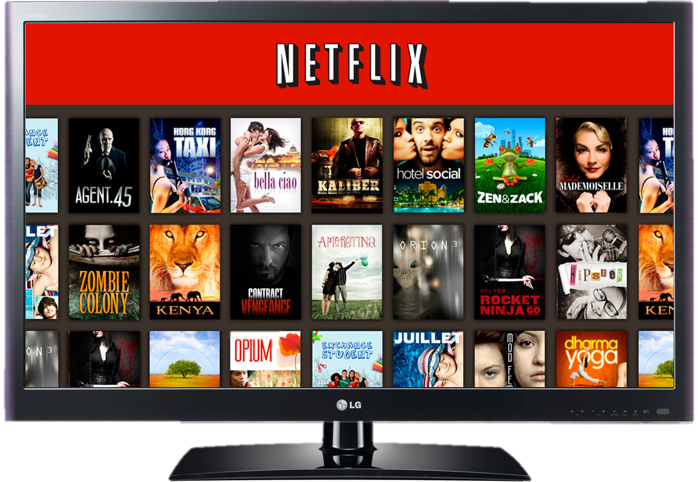
Module 6 · Video 6 · Flat Fee Pricing
Netflix Pricing Strategy
 | Standard with Ads | Standard | Premium
Monthly cost (US$) | $8.99 | $19.99 | $26.99
Screens you can watch at the same time | 2 | 2 | 4
Devices you can download on | 2 | 2 | 6
Unlimited movies, TV shows and mobile games | ✓ | ✓ | ✓
Watch on laptop, TV, phone and tablet | ✓ | ✓ | ✓
HD (1080p) available | ✓ | ✓ | ✓
Ultra HD (4K) and HDR available |  |  | ✓
Ads | yes | — | —
Extra member slots | — | 1 | 2
This pricing strategy is a mix of flat fee and versioning
Management 405 · Module 6 · Complex Pricing and Advanced Pricing Strategies
6
Notes:
Netflix as versioning. Three plans on the table: Standard with Ads at $8.99, Standard at $19.99, and Premium at $26.99. What separates them costs Netflix almost nothing. The number of screens you can watch at once, the download slots, 4K, and whether ads run. The price differences are far larger than the cost differences, which is the whole point of versioning. Worth asking the class which plan they are on and why they did not take the cheaper one. There is a good discussion of the 2017 price increase and the backlash it drew at https://finance.yahoo.com/news/netflix-price-hikes-wont-hurt-subscriber-growth-211526185.html

